Slide 1

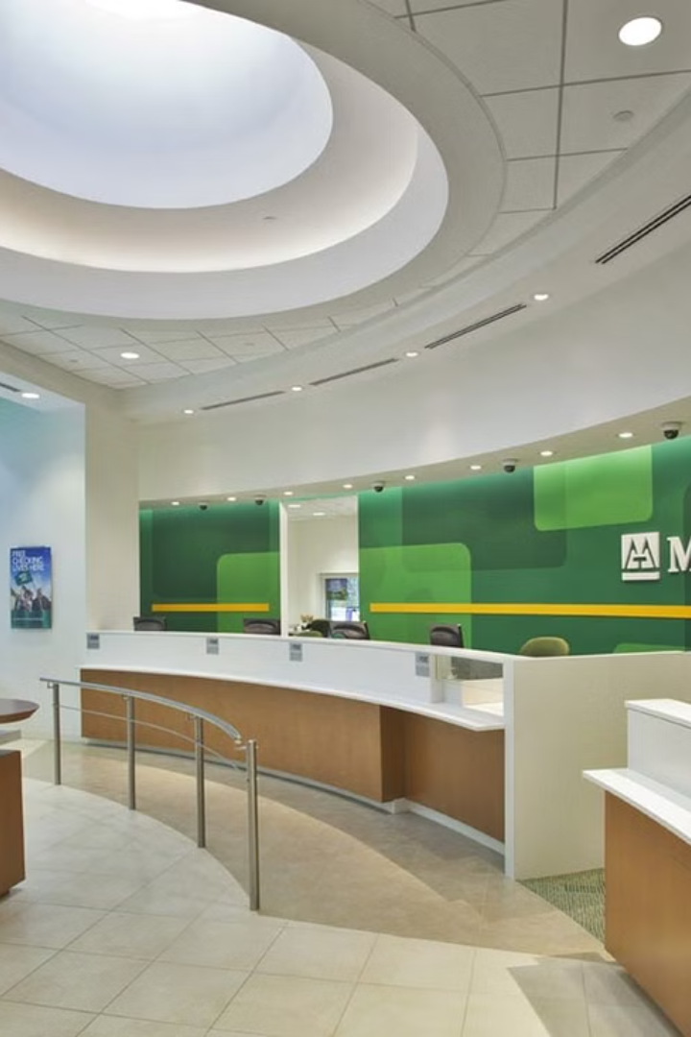
Data-Driven Insights for Mitron Bank's New Credit Card Line
Unveiling insights into Mitron Bank's customer demographics, spending behaviors, and income with the ultimate goal of tailoring credit cards to customer needs and market trends

Slide 2

Problem Statement
Mitron Bank seeks to enhance its market presence and customer satisfaction through the introduction of a new line credit card.
Challenges
The challenge lies in leveraging data-driven insights to tailor these credit cards effectively to meet diverse customer needs and align with prevailing market trends.

Slide 3

Objective
1
Customer Needs Analysis
2
Market Trend Identification
Analyze customer preferences and spending habits to tailor credit card features according to their requirements
Identify emerging market trends to ensure Mitron Bank's credit cards remain competitive and appealing
3
Product Differentiation Strategy
Develop strategies to differentiate Mitron Bank's new credit cards from competitors based on customer needs and market trends

Slide 4
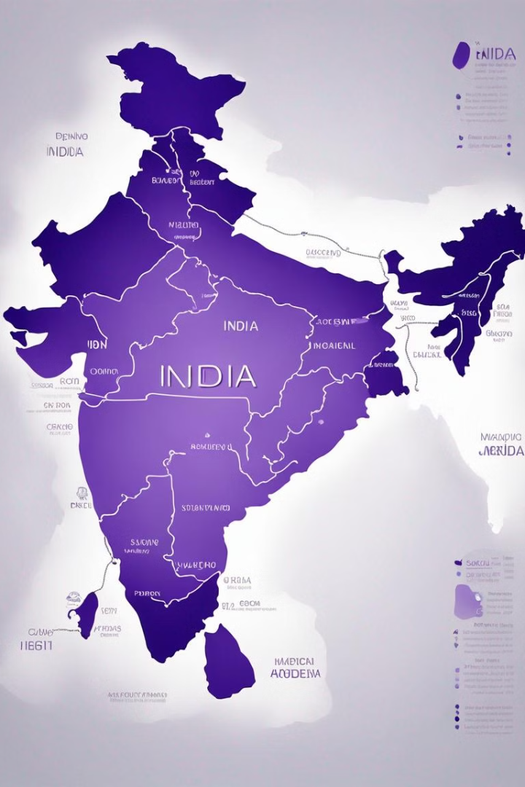
Customer Distribution in Major Indian Cities
The major cities where the customers are distributed are as follows:
Mumbai: 1078 customers
Chennai: 834 customers
Bengaluru: 751 customers
Delhi NCR: 744 customers
Hyderabad: 593 customers
Total customers: 4000

Slide 5
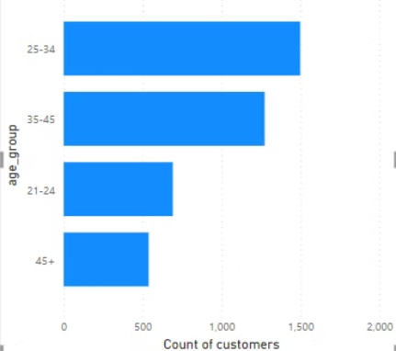
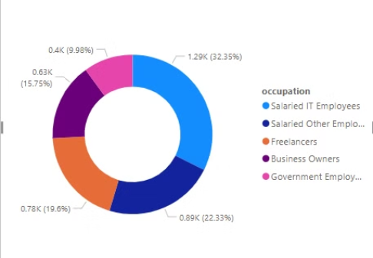
Demographic Insights of Customers
Age Groups Analysis
Occupation Analysis
Majority of customers fall within the 25-34 age bracket, followed by the 35-45 age group.
Salaried IT employees: Largest segment, representing 32.35% of customers.
Salaried employees (other sectors): 22.33%.
The 21-24 age group represents a significant portion of customers.
Freelancers and Business owners: Also substantial segments.
Relatively fewer customers are in the 45+ age group.
Government employees: Smallest segment, comprising only 9.98% of customers.

Slide 6
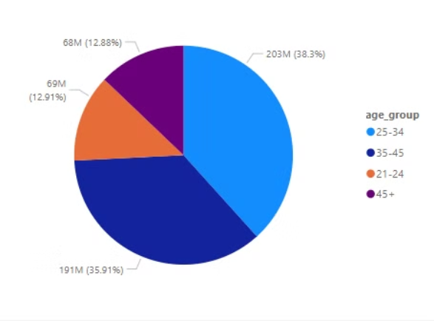
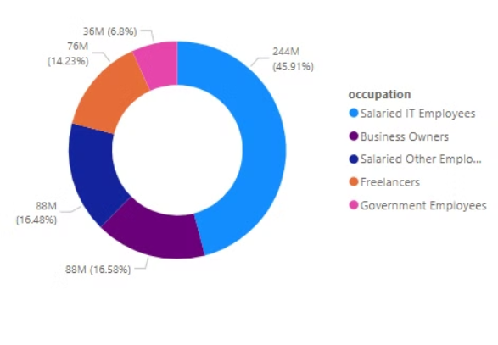
Spending Insights of Customers
By Age Groups
By Occupation
Customers aged 25-34 account for the highest spending, constituting 38.3% of total spend in the data.
Salaried IT employees lead in spending, contributing 45.91% of the total spending amount.

Slide 7
Spending Patterns of Customers
Category
Percentage of Spending
Bills
19.76%
Groceries
16.26%
Electronics
14.99%
Health & Wellness
12.36%
Travel
11.16%
Food
8.29%
Entertainment
7.78%
Apparel
6.41%
Others
3.01%

Slide 8
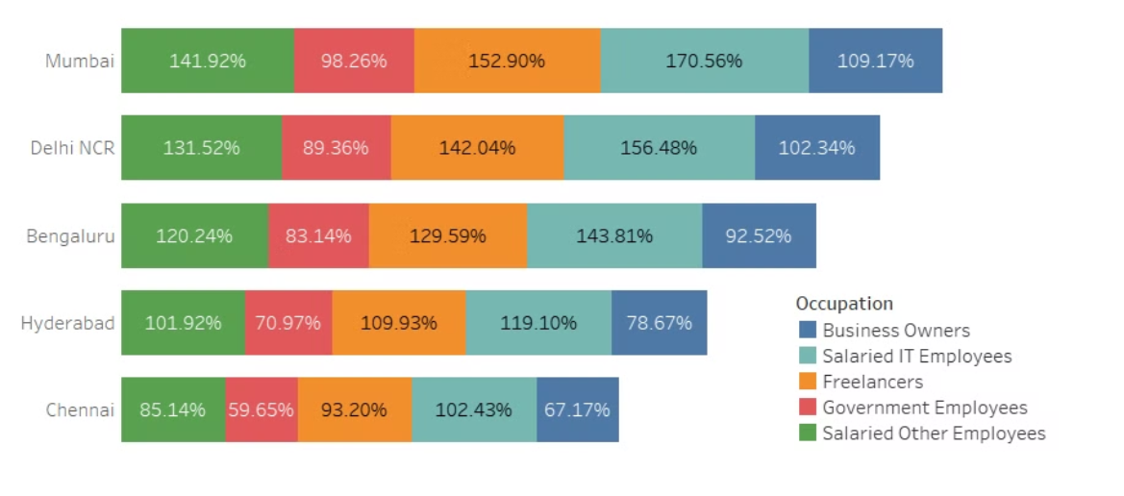
Income Utilization: City-wise Analysis
“Mumbai “↗ has the highest income utilization.
&
"Salaried IT employee” predominant across all cities.

Slide 9

Recommendations Based on the Insights
Customer Segments
Product Features
Target Product launch towards customers in Mumbai, Bengaluru and Delhi NCR.
Young Clients (21-24 age-group) are likely to respond to rewards for Entertainment, Electronics, Apparel, Food
Target product launch to customers under 45 years of age
Clients between 25-45 age band are likely to respond to rewards for Bills, Groceries, Travel, wellness
Gender-Centric Segmentation
Male: Offer Credit card features with rewards Bills, Groceries, Electronics.
Female: Introduce credit card features with Health & Wellness, Apparel, Travel

Slide 10

Strategies to Differentiate Credit Cards from Competitors
1
Innovative Value Propositions
Introduce unique benefits such as lifestyle perks, exclusive experiences, and personalized services.
Leverage insights from customer preferences to offer rewards and benefits not available with competitors.
2
Tailored Marketing Campaigns
Craft targeted marketing messages that resonate with specific customer segments.
Highlight the distinct features and benefits of Mitron Bank's credit cards compared to competitors
3
Continuous Product Innovation
Stay ahead of the competition by regularly introducing new features and benefits based on market trends.
Encourage customer feedback and engagement to drive ongoing improvements.

Slide 11
Strategies to Differentiate Credit Cards from Competitors
4
Strategic Partnerships
Establish partnerships with well-known brands, retailers, or service providers to offer exclusive deals, discounts, or rewards to its credit cardholders
For example,
Airlines Partnership:
Exclusive lounge access.
Priority boarding.
Discounted airfare.
Luxury Hotels Partnership:
Complimentary room upgrades.
Spa treatments.
Dining credits.

Slide 12
Conclusion and Next Steps
1
Analysis Completion
Data analysis reveals key insights into customer demographics, spending habits, and preferences.
2
Recommendations
Identified opportunities to tailor credit card features to meet customer needs and market trends.
3
Feedback Collection
Gather feedback from customers regarding the implemented changes.

